Slide 1
PUBLIC KEY ENCRYPTION
Reporters:
Owen Duque
Eurie Gene Pilande

Slide 2
Public key encryption, or public key cryptography, is a method of encrypting data with two different keys and making one of the keys, the public key, available for use by anyone. The other key is known to be the private key. Data encrypted with the public key can only be decrypted using the private key, and data encrypted with the private key can only be decrypted using the public key.
Public key encryption is also referred to as asymmetric encryption. It is widely used, particularly for TLS/SSL, which makes HTTPS possible.

Slide 3
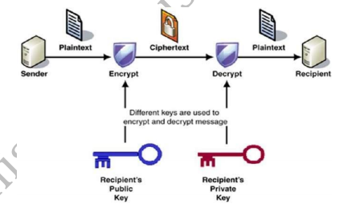

Slide 4
The most important features of the public key encryption scheme are:
Asymmetric Key Usage
Unique Decryption Keys
Publication of Public Key
Assurance of Public Key authenticity
Complex Encryption Algorithm
Mathematical Relationship Between Keys

Slide 5
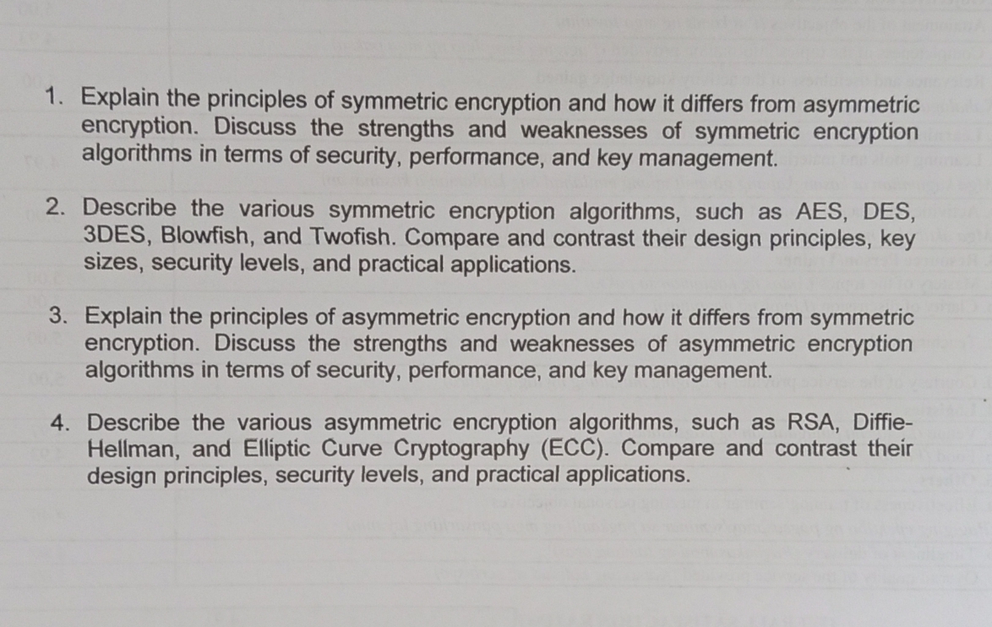

Slide 6
Thank you!

